Slide 1
Final Report
Pneumonia Detection Challenge
By,
Abdul, Abhishek, Tanu, Manish, Ashutosh

Slide 2
Agenda
Summary of problem statement, data and findings
Overview of the final process
Step-by-step walk through of the solution
Model evaluation
Comparison to benchmark
Visualization(s)
Implications
Limitations
Closing Reflections

Slide 3
Problem Statement
Build a deep learning model to detect and classify images of potential pneumonia cases so that doctors can prioritize and expediate their review.
The model should predict whether pneumonia exists in a given image.
The application should also predict by predicting bounding boxes around areas of the lung.
Samples without bounding boxes are negative and contain no definitive evidence of pneumonia.
Samples with bounding boxes indicate evidence of pneumonia

Slide 4
DataSet Used
We are using the datasets provided by RSNA on Kaggle, we have downloaded a copy of these files
stage_2_train.csv - the training set. Contains patientIds and bounding box / target information.
stage_2_detailed_class_info.csv - provides detailed information about the type of positive or negative class for each image.
stage_2_train_images – set of training images
Stage_2_test_images - set of test imags

Slide 5
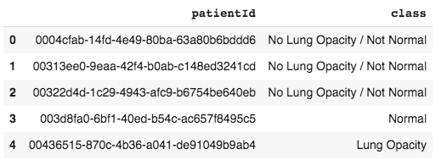
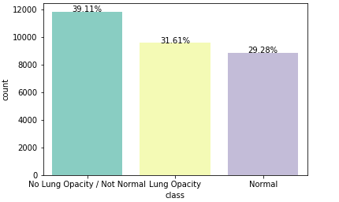
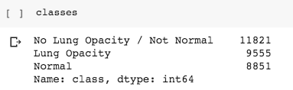
Overview of the final process
Exploratory Data Analysis-
Preliminary EDA insights -class_info dataset
•30227 rows and 2 columns
-patientId and class
•Missing values –nil
•26684 unique patients
•Class distribution

Slide 6
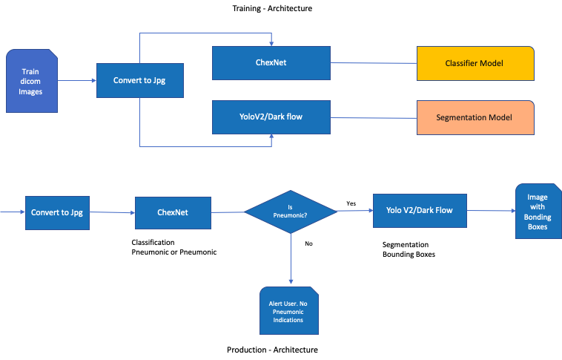

Slide 7
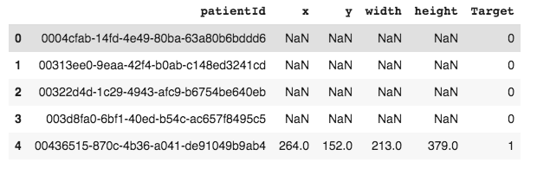
Preliminary EDA insights -train labels dataset
•30227 rows and 6 columns
-patientId and x, y coordinates, width, height of the bounding boxes and target indicating Pneumonic case or not
•Missing values –nil
•26684 unique patients

Slide 8
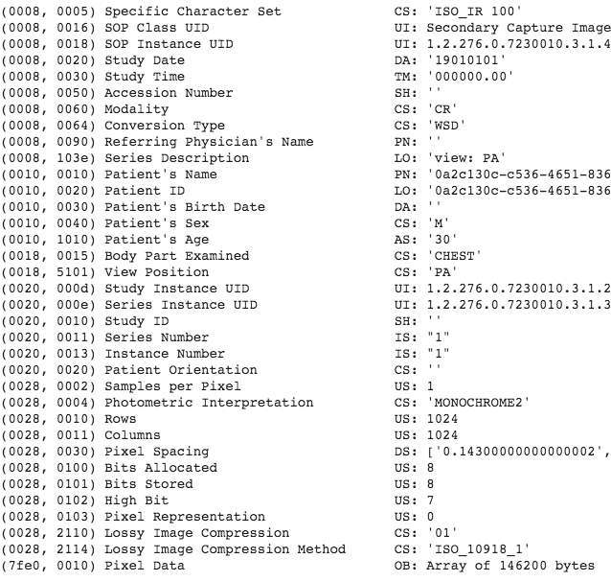
Preliminary EDA insights –training images
•Training has 26684 images
•Images are dcm format
•Every image has the following details
-Patient sex;
-Patient age;
-Modality;
-Body part examined;
-View position;
-Rows & Columns;
-Pixel Spacing.

Slide 9
Algorithms Used-
YOLO/OpenCV DarkFlow –TensorFlow implementation of YOLO
ChexNet to identify Pneumonia Patient

Slide 10
Step-by-step walk through of the solution
Build a deep learning model to detect and classify images of potential pneumonia cases so that doctors can prioritize and expedite their review.
The model should predict whether pneumonia exists in a given image.
The application should also predict by predicting bounding boxes around areas of the lung.
Samples without bounding boxes are negative and contain no definitive evidence of pneumonia.
Samples with bounding boxes indicate evidence of pneumonia.

Slide 11
Model evaluation
●The evaluation metrics is based on the mean average precision at different intersection over union (IoU) thresholds. The IoUof a set of predicted bounding boxes and ground truth bounding boxes is calculated as:
IoU(A,B)=A∩BA∪B.IoU(A,B)=A∩BA∪B.
●The metric sweeps over a range of IoUthresholds, at each point calculating an average precision value. The threshold values range from 0.4 to 0.75 with a step size of 0.05:(0.4, 0.45, 0.5, 0.55, 0.6, 0.65, 0.7, 0.75). In other words, at a threshold of0.5, a predicted object is considered a "hit" if its intersection over union with a ground truth object is greater than 0.5.
●At each threshold valuett, a precision value is calculated based on the number of true positives (TP), false negatives (FN), and false positives (FP) resulting from comparing the predicted object to all ground truth objects:
TP(t)TP(t)+FP(t)+FN(t).TP(t)TP(t)+FP(t)+FN(t).
●A true positive is counted when a single predicted object matches a ground truth object with an IoUabove the threshold. A false positive indicates a predicted object had no associated ground truth object. A false negative indicates a ground truth objecthad no associated predicted object.

Slide 12
Important note:if there are no ground truth objects at all for a given image, ANY number of predictions (false positives) will result in the image receiving a score of zero, and being included in the mean average precision.
The average precision of a single image is calculated as the mean of the above precision values at each IoUthreshold:
1|thresholds|∑tTP(t)TP(t)+FP(t)+FN(t).1|thresholds|∑tTP(t)TP(t)+FP(t)+FN(t).
●Bounding boxes will be evaluated in order of their confidence levels in the above process. This means that bounding boxes with higher confidence will be checked first for matches against solutions, which determines what boxes are considered true and false positives.
Intersection over Union (IoU)
●Intersection over Union is a measure of the magnitude of overlap between two bounding boxes (or, in the more general case, two objects). It calculates the size of the overlap between two objects, divided by the total area of the two objects combined.
●The two boxes in the visualization overlap, but the area of the overlap is insubstantial compared with the area taken up by bothobjects together. IoUwould be low -and would likely not count as a "hit" at higher IoUthresholds.

Slide 13
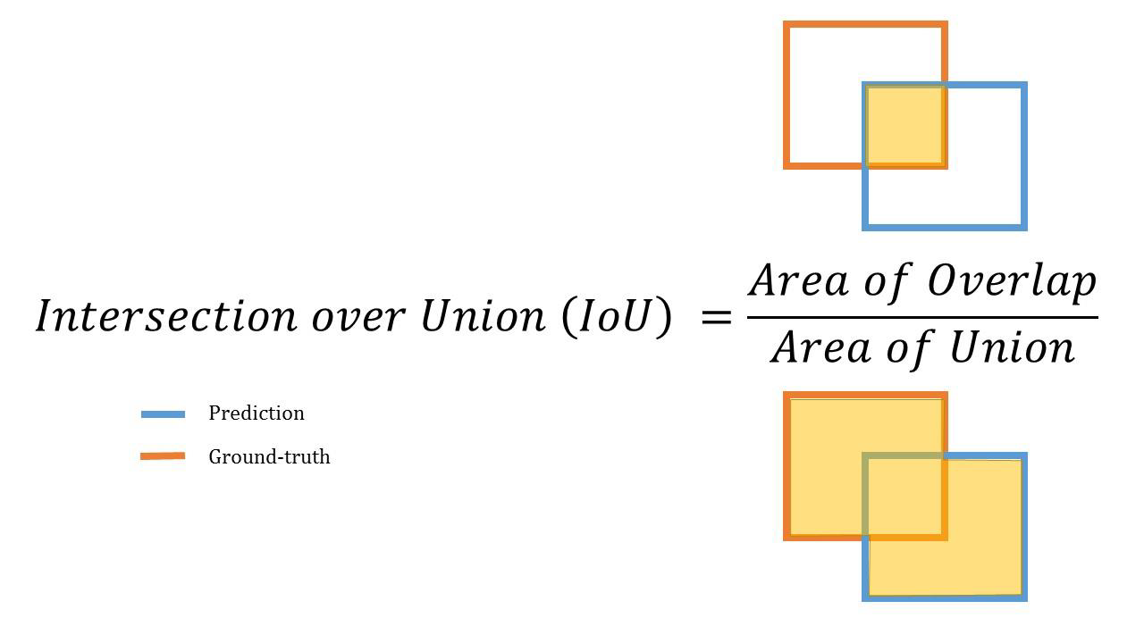

Slide 14
Comparison to benchmark
CheXNet accuracy is used as the standard for the benchmark purpose.
Currently, accuracy achieved with this RSNA dataset using CheXNet is 76.8%
We have created the model using YOLO and it is providing the accuracy as 78.2%

Slide 15
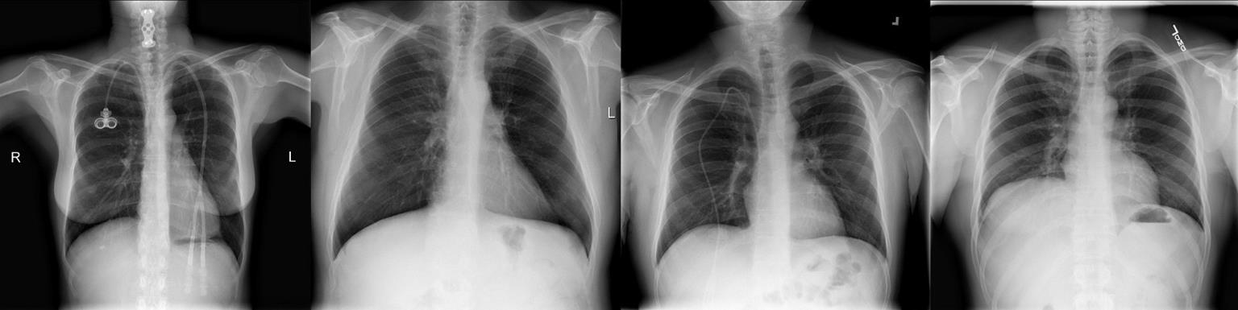
Visualization
Exploratory visualization
•Normal lungs are filled with air. In the x-rays below, you can see normal lungs. We can note that we mostly see white skeletal matter and black matter, which is primarily air.

Slide 16
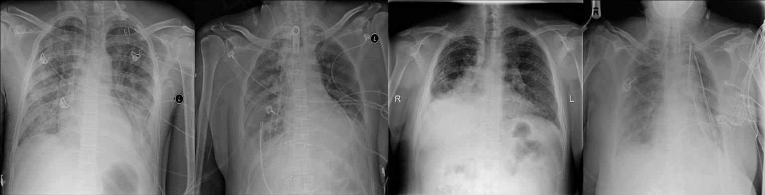
When a person has pneumonia, however, air is replaced by fluid, bacteria, immune system cells, and other objects In an xray, the opacities tend to have a greyish color, and a cloudy appearance, rather than being black or white You can see some images with pneumonia related opacities below.

Slide 17
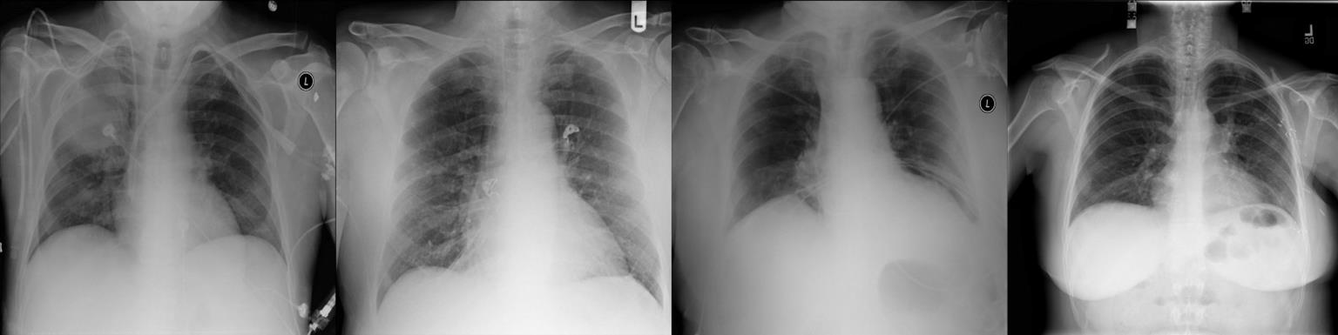
While we are theoretically detecting “lung opacities”, there are lung opacities that are not pneumonia related
In the data, some of these are confusingly labeled “Not Normal No Lung Opacity” These non pneumonia “Not Normal” detections end up being a primary source of frustration in building models
The images below show a few of the examples in the “Not Normal” class.

Slide 18
Implications
We have build an algorithm to detect a visual signal for pneumonia in medical images to improve the efficiency and reach of diagnostic services.
Here’s the backstory and why solving this problem matters.
Pneumonia accounts for over 15% of all deaths of children under 5 years old internationally. In 2017, 920,000 children under the age of 5 died from the disease. In the United States, pneumonia accounts for over 500,000 visits to emergency departments and over 50,000 deaths in 2017,, keeping the ailment on the list of top 10 causes of death in the country.
While common, accurately diagnosing pneumonia is a tall order. It requires review of a chest radiograph (CXR) by highly trained specialists and confirmation through clinical history, vital signs and laboratory exams. Pneumonia usually manifests as an area or areas of increased opacity on CXR. However, the diagnosis of pneumonia on CXR is complicated because of a number of other conditions in the lungs such as fluid overload (pulmonary edema), bleeding, volume loss (atelectasis or collapse), lung cancer, or post-radiation or surgical changes. Outside of the lungs, fluid in the pleural space (pleural effusion) also appears as increased opacity on CXR. When available, comparison of CXRs of the patient taken at different time points and correlation with clinical symptoms and history are helpful in making the diagnosis.
CXRs are the most commonly performed diagnostic imaging study. A number of factors such as positioning of the patient and depth of inspiration can alter the appearance of the CXR, complicating interpretation further. In addition, clinicians are faced with reading high volumes of images every shift.

Slide 19
Limitations
1.Infrastructure - GPU
2.Quality labeled image
3.Access to radiology
Need to work with the hospitals to check the efficiency of the model

Slide 20
Closing Reflections
Shallow practical knowledge
Process pipeline
Domain understanding of health care side
Team effort & collaboration
Diversified profile of team mates.
Good understanding of deep learning is required

